Slide 1

Harnessing Data-Driven Inventory Management to Boost Profits in Pipes and Sanitary Ware Store
BDM Project by,
PIYUSH KANT
22F3002119

Slide 2
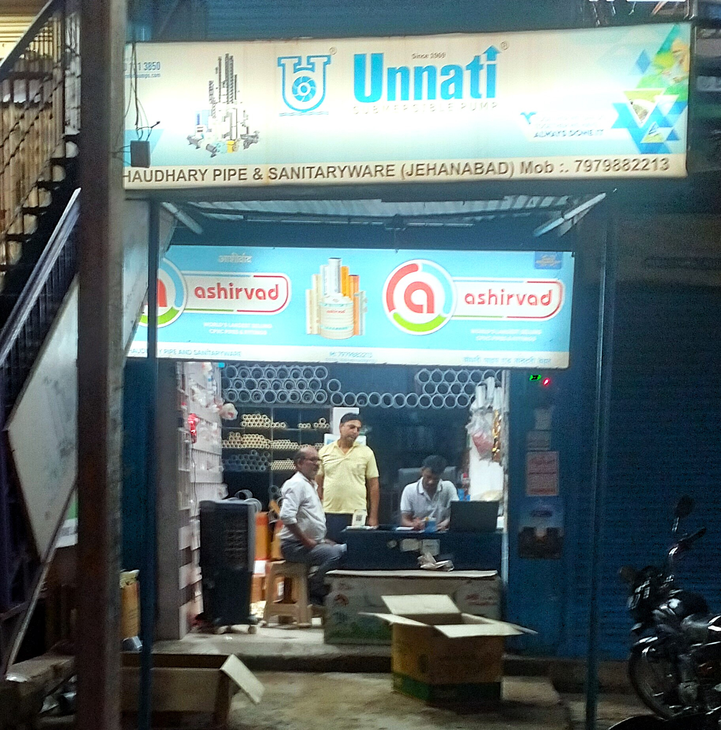
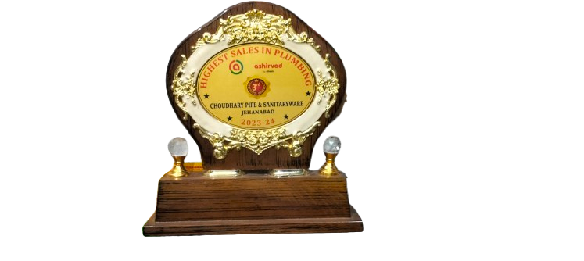
Business Overview
Shop Name: CHAUDHARY PIPES AND SANITARY WARE
Owner Name: Mr. Sanjay Kumar
Since: 2017
Specializes in: Plumbing and Sanitary products.
Customer Type: Retail and Wholesale
Main Brands Offered: Ashirvad, Finolex, Pearl, and Unnati.
Location: NH22, Jehanabad (Bihar)
Awards: Highest Sales in Plumbing (Ashirvad 2023-24)

Slide 3
Project Workflow
Problem Identification
Data Collection
Analysis
Result
Inefficient Inventory Management
Sales Data
Purchase Data
Monthly Sales Trend
Combined the results of all analysis
Category-Wise Sales Analysis
Data Cleaning Using Excel and Pandas
Profitability
ABC Analysis
Product Categorization
Customer Satisfaction
6-Months Data
XYZ Analysis

Slide 4
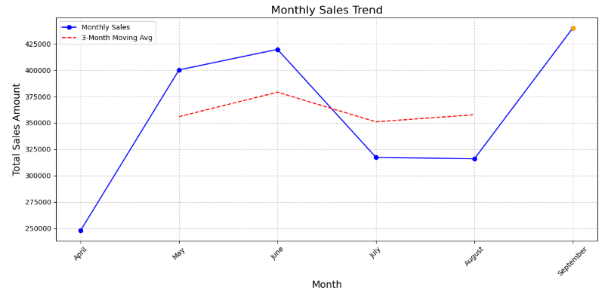
Monthly Sales Trend
September (The Sales at its peak)
April (The lowest revenue generating month)
A general decline after the peak in June.
Also a slower recovery toward September.

Slide 5
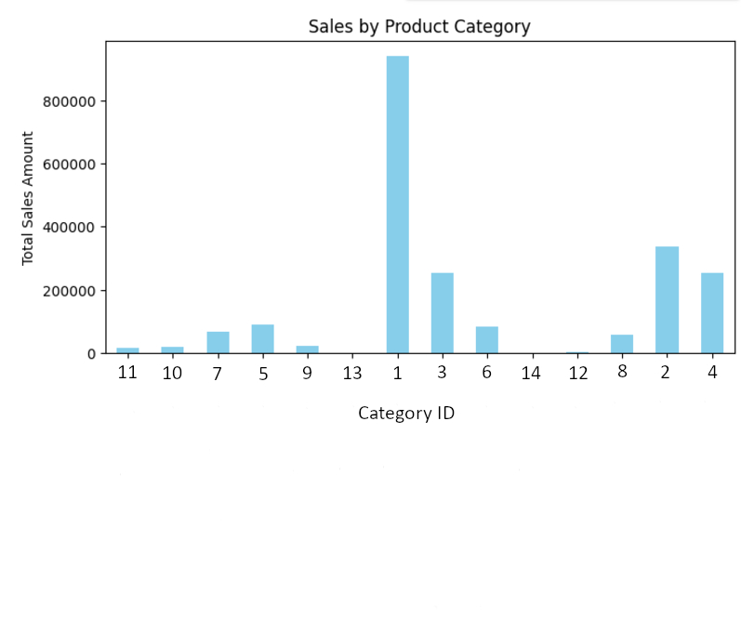
Category-wise Sales Analysis
Pipe Fittings
Traps and Bends
Pipes
Valves and Taps
Lubricants and Adhesives
Plumbing fixtures and Accessories
Fasteners and Connectors
Toilet and Sanitary Accessories
Miscellaneous tools
Electrical Components and Wiring
Drainage and waste management
Structural and Support rods
Storage and Water supply
Motors and Pump System
Pipe Fittings

Slide 6
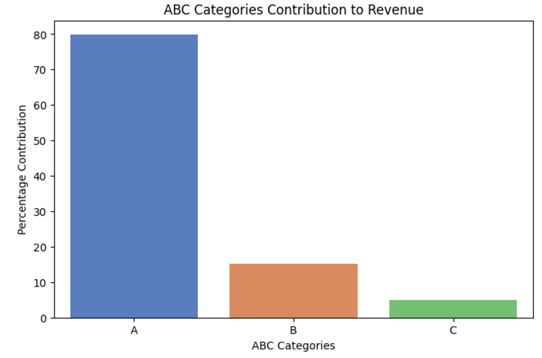
ABC Analysis
631 Items
A
95 Items
Contribution:
₹ 9,264,436.21
B
155 Items
Contribution:
₹ 1,752,736.65
C
381 Items
Contribution:
₹ 582,209.17
A: 79.87%
B: 15.11%
C: 5.02%

Slide 7
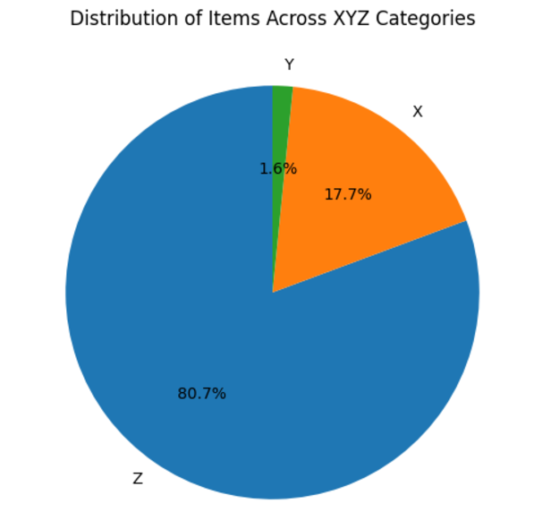
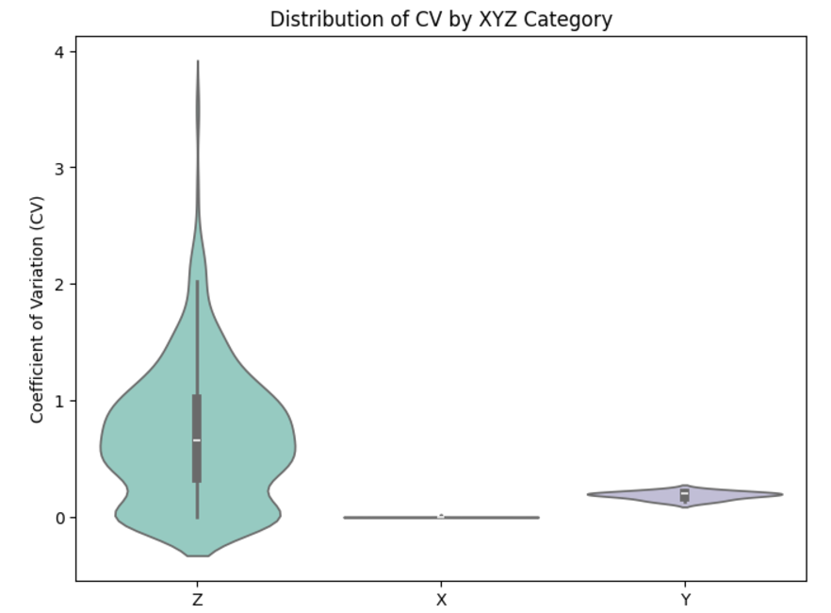
XYZ Analysis
Categorization based on Demand Stability
X
Lowest Variability
17.7%
Y
Moderate Variability
1.6%
Violin Plot
Z
Highest Variability
80.7%
CV is the key in this analysis.
Long tail in Z Demand Uncertainty
Outliers in Z Rarely Sold Items.
Wide Spread Suggesting high demand variation
Narrow Spread Suggesting Occasional spikes in demand.
Variability as good as zero.

Slide 8
Combination of ABC and XYZ Analysis
AX, AY, AZ, BX, BY, BZ, CZ, CY, CZ
Combined Categories
Products in each combined Categories.
3 Categories
3 Categories
ABC Analysis Results
XYZ Analysis
Results
 | X | Y | Z
A | High Value, Low variability | High Value, Moderate Variability | High Value, High Variability
B | Medium Value, Low Variability | Medium Value, Moderate Variability | Medium Value, High Variability
C | Low Value, Low Variability | Low Value, Moderate Variability | Low Value, High Variability

Slide 9
Recommendations
AX
Maintain Safety Stock, Automated Replenishment
AY
Demand Forecasting, Moderate Safety Stock
AZ
Avoid Overstocking with make to order.
BX
Steady Stock Levels, Regular Reordering
BY
Seasonal Monitoring, Buffer stock Strategy
BZ
Avoid Overstocking, Consider More predictable alternatives
CX
Bulk Ordering, Minimize Monitoring
CY
Low Stock Levels, Occasional Trend Monitoring
CZ
Stock on-demand only.

Slide 10
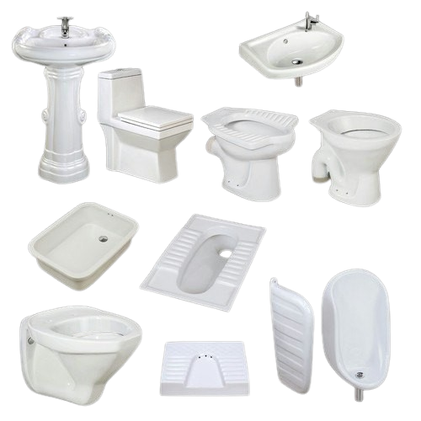
Some more Recommendations
Sanitary Wares are very vulnerable products. This product category is also producing a comparatively lower revenue. The stock should be minimized.
The stocks for Lubricants and Adhesives must not be empty.
The storage space should be bigger.
Capitalize on the factors behind September’s rebound to sustain growth. (Monthly Sales Trend)
Thank You

